Slide 1
Integrated Change Control
Part of the Project Integration Management Process:
the processes and activities to identify, define, combine, unify, and coordinate processes (tasks) and activities within a project.

Slide 2
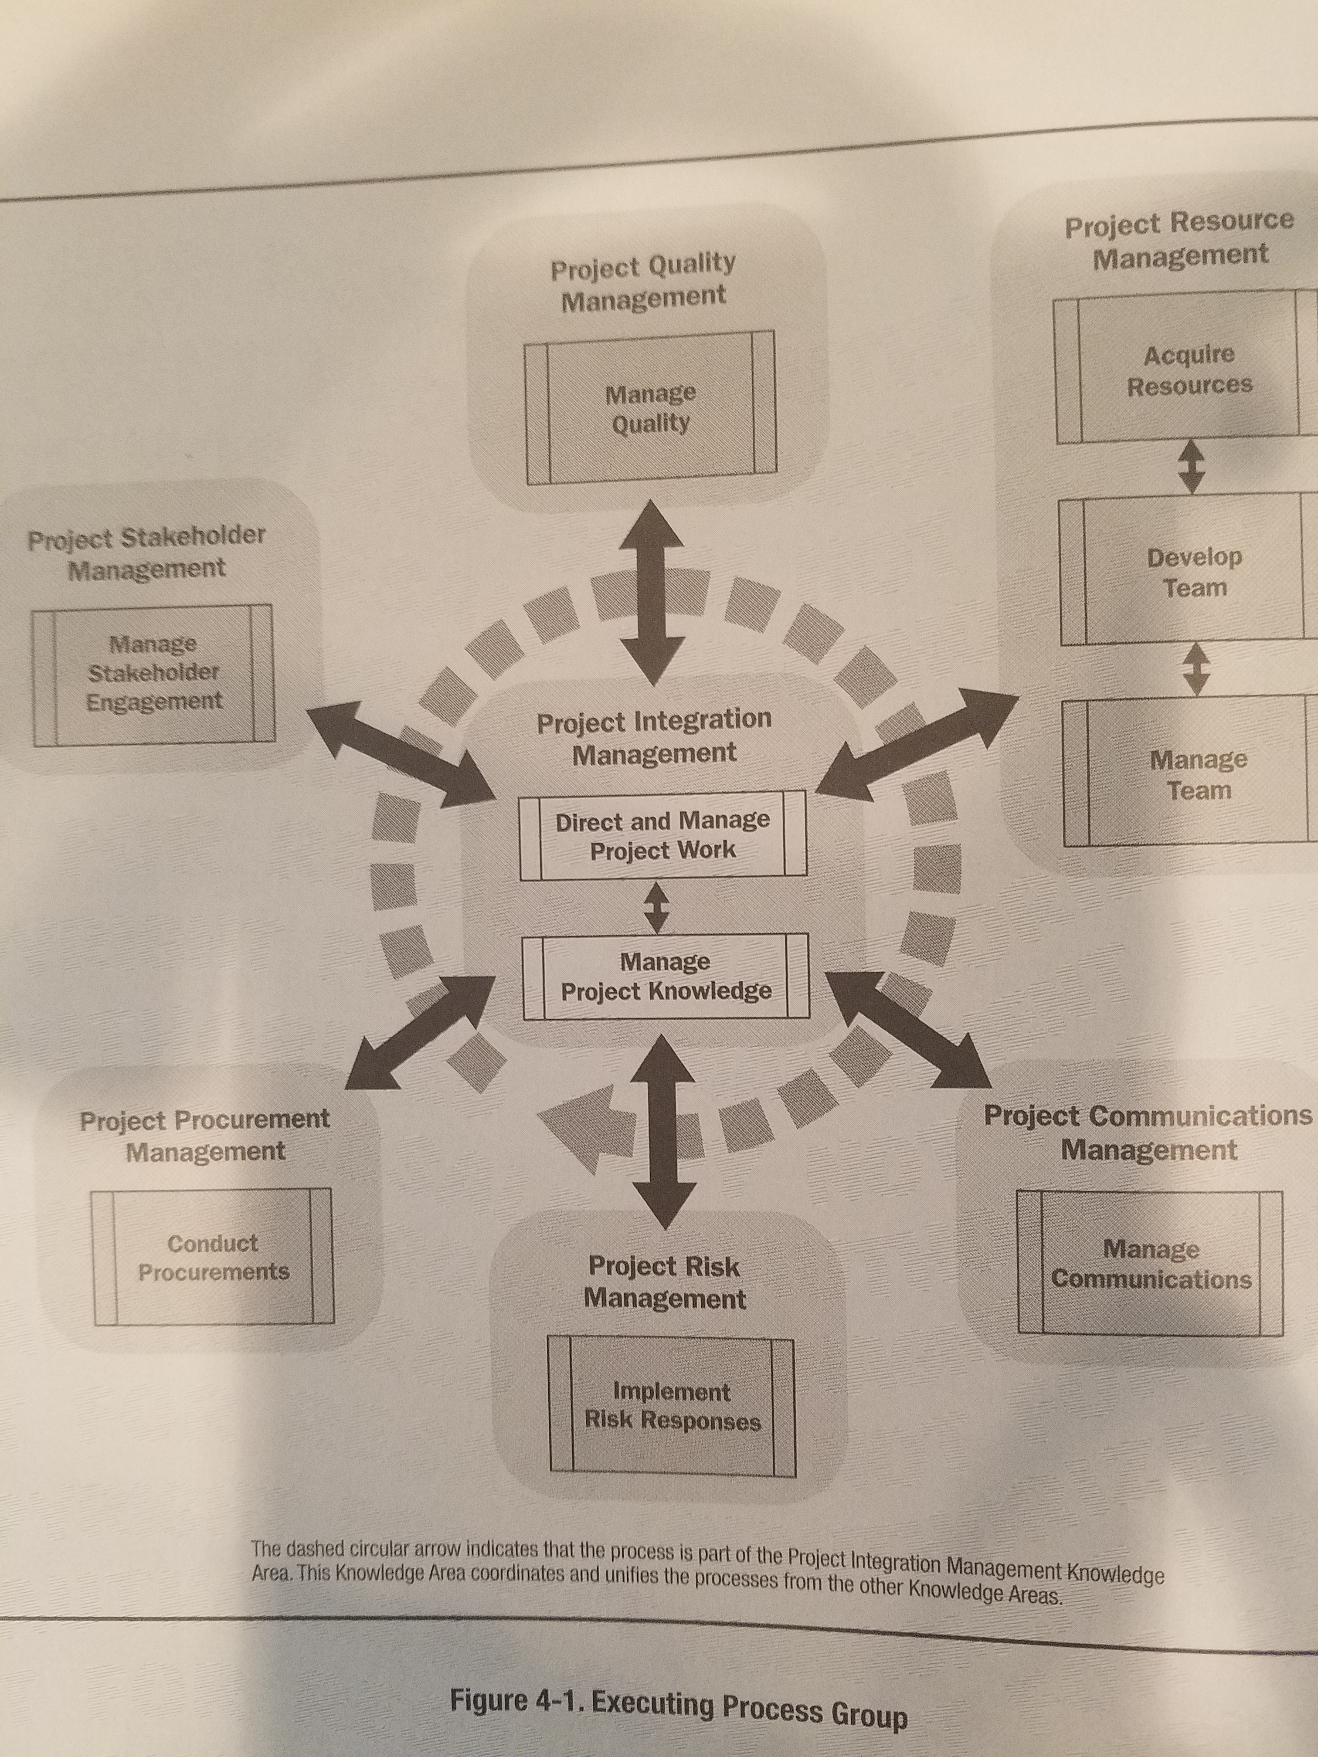
Performed throughout the Project
Ensures unification, consolidation, communication, and interrelationship within projects

Slide 3
KEY BENEFITS
1. Allows for documented changes within the project to be considered in an integrated manner while addressing overall project risk.
2. Addresses risks which often arise from changes made without consideration of the overall project objectives or plans.
3. The process is performed throughout the project.

Slide 4
What is Needed
Project Management Plan: Change Management plan, Configuration management plan, Scope Baseline, Schedule Baseline, Cost baseline
Project documents: Basis of estimates, Requirements traceability matrix, Risk report
Work Performance Reports
Change Requests
Enterprise Environmental Factors
Organizational Process Assets

Slide 5
Change Requests
Show requests to modify a document, deliverable, or baseline- definition of change request
Perform a corrective action
Perform a preventative action
Perform a defect repair
Include options
Questions?

Slide 6



Example of a Change Request
Change Request
Change ID | Version 2.9
Change Requestor | FDA Commissioner
Change Documented By | Project Manager
Changed Description |  | We would like to include an interactive video to display every time an user logs into Nexus.
Change Impact |  | Schedule Impact: | If this change request is incorporated into the project schedule the project delivery will be delayed by 2 months
 |  | Scope Impact: | None
 |  | Budget Impact: | The budget will increase by 150,000 as the schedule will stretch by 8 weeks and the resources will remain on the project for a longer time.
 |  | Quality Impact: | None
 |  | Other Impacts: | External clients will need to be communicated about the delay. Internal project XYZ will be impacted as requires will remain on this project for a longer time
Options |  | Option 1: Approve the change reques and extend the project for 2 months
 |  | Option 2: With option 1, if additional resources are added to the project the schedule impact can be mi8nimized but the budget impact will increase to $250,000
 |  | Option 3: Deliver the project with the component in question and schedule the reminder of the work as a different project
 |  | Note/Recommendation: The project team recommends option 2.
Change Approved Date |  | 12/12/2019
Change Approved By |  | Project Sponsor
Show requests to modify scope, schedule, or cost baseline
Perform a corrective action
Perform a preventative action
Perform a defect repair
Include options

Slide 7
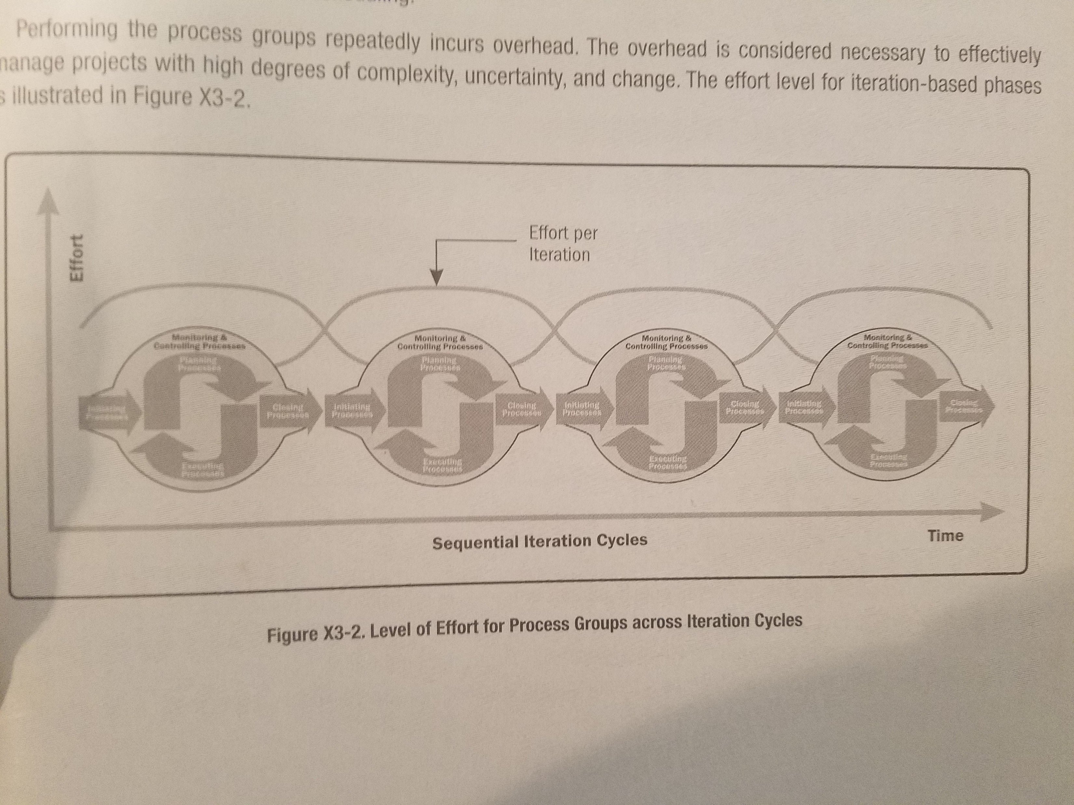
What is not needed
A specific workflow- projects are dynamic
Exhaustive documentation
Long meetings
  Meetings are part of the tools but are part of execution which means that refinements are made with customer approval

Slide 8
What We Obtain from this Process
1. Approved change requests
2. Project Management Plan updates: Any component
3. Project document updates: Change log
Which allows for documented changes within the project to be considered in an integrated manner while addressing overall project risk.

Slide 9
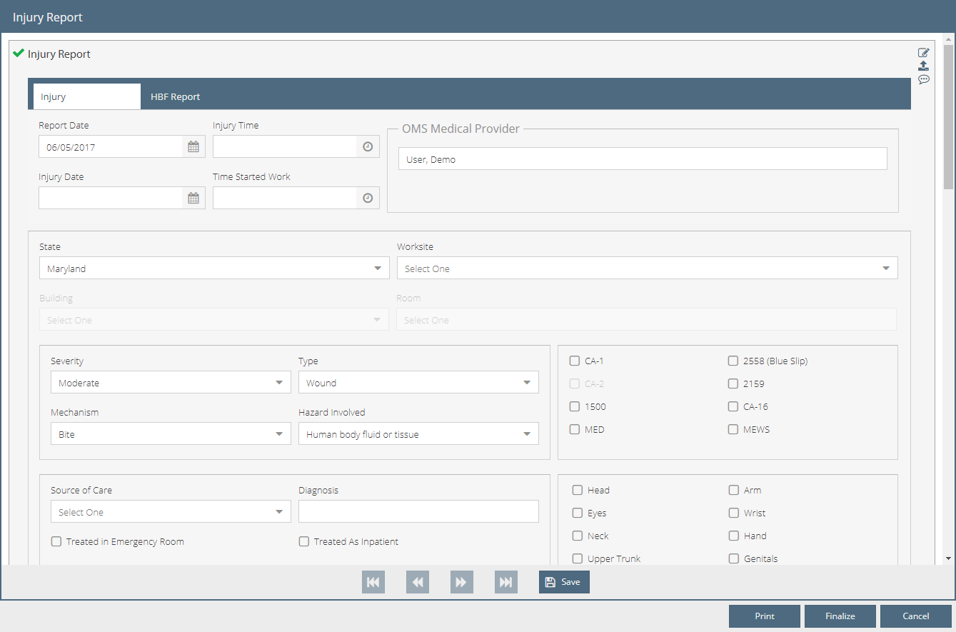
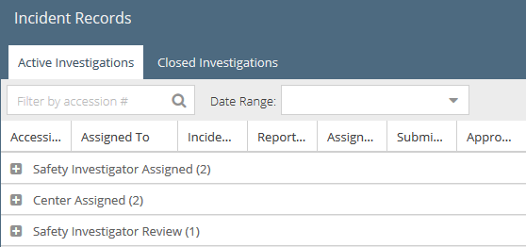
Example of how Integrated Change Control is useful
1. When an incident is created in EMR the information is pushed over to WIM where it is finished by the investigator. The incident can be reviewed by the lead OSHO and the OLSS but any changes made are not pushed back to the EMR module.
2. Integrated Change Control can help with this by reviewing the configuration management plan, the requirements traceability matrices, and the project objectives and plans in order to manage the interdependencies among the knowledge areas and Nexus Modules
Questions?

Slide 10
Change Management Plan
Change Management Plan
Change Control Board Members
Roles
Responsibilities
Communication Process for Change Control Request
Communication Requirements and Frequency
Schedule Tracking and Monitoring (Variance Analysis)
Cost Monitoring and Tracking
Scope Monitoring and Tracking
Time Frame for Response of the members of the Change Control Board
 | Role 1 | Role 2 | Role 3 | Role 4 | Role 5 | Role 6 | Role 7
Cost Request
Schedule Request
Scope Request
Other Impacts
Notes

Slide 11
Configuration Management Plan
Configuration Management Plan
Document Owner: | Ajeya Khamu
Release Number : | V2
Project Title: | WIIM Integration
Author: | Emi Akiode | Client: | FDA
Purpose: A record of the information required about a product's status
Project Artifact Identifier | LSM
Type of Artifact under Configuration Control | Module
Latest Version Number | V.2
Product Description | Internet module of laboratory surveys to be completed
Life Cycle Steps Appropriate to the Product | Monitor and control then close. After original configuration planning is completed.
Product Owner | Ajeya Khamu
Date Allocated | Jan-18
Location where the Product is kept | Internal Server behind a firewall at HealthRx
Source | Source Code is behind Firewall
Links to Related Products | Links include online resource and MSDS.com and solutions
Weekly Report Status | Updated but requires integrations with DIM documents and Analytics
Copy Holders or Potential Users | FDA and NIH
How to report project Issues | DIM documents are preventing data from being shared with other modules so we will perform unit testing of the code during a time when there are no changes being made

Slide 12
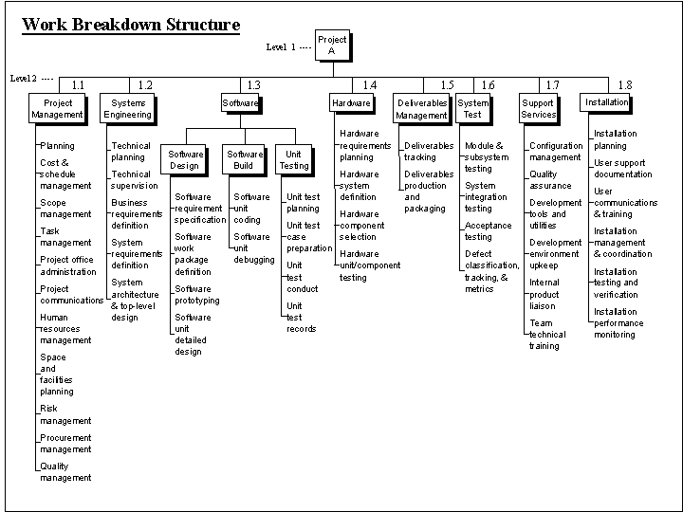
Scope Baseline
WBS Dictionary
Project Title: |  | Date Prepared:
Description of Work
Milestones |  |  | Due Dates
ID | Activity | Resource | Labor |  |  | Material |  |  | Total Cost
 |  |  | Hours | Rate | Total | Units | Cost | Total
Quality Requirements
Acceptance Criteria
Technical Information
Contract Information
Project Scope Statement
Project ID |  | Date
Project Name
Project Objectives
Product Scope Definition
Project Requirements
Project Boundaries
Project Deliverables
Product Acceptance Criteria
Project Constraints
Project Assumptions
Initial Project Organization
Schedule Milestones
Fund Limitation
Approval Requirements

Slide 13
Cost Baseline
Cost Baseline
Work Package Items | 1 | 2 | 3 | 4 | 5 | 6 | 7 | 8 | 9 | 10 | 11 | 12 | Totals
1. Hardware
1.1 Handheld Devices |  |  | $30,000 | $30,000 |  |  |  |  |  |  |  |  | $60,000
1.2 Servers |  |  | 8,000 | 8,000 |  |  |  |  |  |  |  |  | $16,000
2. Software
2.1 Licensed Software
2.2 Software Development
3. Testing
4. Training and Support
4.1 Trainee cost |  |  |  |  |  |  |  | 50,000 |  |  |  |  | 50,000
4.2 Travel Cost |  |  |  |  |  |  |  | 8,400 |  |  |  |  | 8,400
4.3 Project team members
5. Project Management
5.1 Project Manager
5.2 Project team members
5.3 Contractors
6. Reserves
Totals |  |  |  |  |  |  |  |  |  |  |  |  | $$
Signed By: |  |  |  | Date: |  | Signed By:

Slide 14
Schedule Baseline
Schedule Baseline
The approved version of a schedule model that can be changed only through formal change control procedures and is used as the comparision to actual results. |  |  | September |  |  |  | October |  |  |  | November |  |  |  | December
 |  |  | 6th-12th | 13th-19th | 20-26th | 27th-3rd | 4th-10th | 11th-17th | 18th-24th | 25th-31st | 1st-7th | 8th -14th | 15th-21st | 22nd-28th | 29th-5th | 6th-12th
Topic/Task | Start | Done | 1 | 2 | 3 | 4 | 5 | 6 | 7 | 8 | 9 | 10 | 11 | 12 | 13 | 14
Requirements Documentation Series 1 | 1 | 1
Series 2 | 2 | 2
Series 3 | 3 | 3
Series 4 | 4 | 4
Sign Agreement | 5 | 5
Install on Server | 5 | 5
Software Intiation | 6 | 6
Storyboarding | 6 | 6
User Configuration | 7 | 7
Write Roles in Configuration | 8 | 8
Conduct Sweep of Active Directory | 9 | 10
Initial Install of preconfiguration setting
Draft reports of the system | 2 | 12
User testing | 13 | 13
User training | 14 | 14
Signed By: |  |  |  |  | Date: |  | Signed By: |  |  |  |  |  |  |  | Date:

