Slide 1




Home Inspection Scores and US Multifamily Public Housing
Emi Akiode
May 11, 2022
Notes:
I decided to use data from the United States Department of Housing and Urban Development to understand how supervised and unsupervised modeling concepts can apply to the dataset for multifamily physical home inspection scores.
Making these inspection details available will enable researchers, advocacy groups and the general public to
1) better understand the physical condition of the HUD-assisted housing stock, as well as changes in the stock over time;
2) hold providers accountable for housing quality; and
3) plan for future affordable housing needs.

Slide 2


Recent US News Articles on Public, Affordable or Multifamily Housing
z
Notes:
How can we ask better questions as news consumers? Avoid puppet syndrome
https://duckduckgo.com/?q=news+articles+public+housing&iar=news&ia=news
I decided to use data from the United States Department of Housing and Urban Development to understand how supervised and unsupervised modeling concepts can apply to the dataset for multifamily physical home inspection scores. The information and excel is found here : https://data.hud.gov/data_sets.html. I believe that using data gathered by experts (home inspectors) and data from a reputable website (United States Department of Housing and Urban Development) can help to make my dataset more robust, precise, useful and practical. This data has more variables to work with than my last data set which will help me with generalized models such as lasso and ridge regression. I believe this project is important because it highlights not only the price of a house but the benefits of maintanance on home inspection scoring. Inspection scores rated on a scale of 0-100 can help prospective homebuyers and prospectors understand which counties and regions have houses that actually store value rather than being overly inflated. The score is based on Uniform Physical Condition Standards and Physical Inspection Requirements for Certain HUD Housing; Administrative Process for Assessment of Insured and Assisted Properties and the Federal Register
Description: HUD's Real Estate Assessment Center conducts physical inspections of properties that are owned, insured or subsidized by HUD, including public housing and multifamily assisted housing. About 20,000 such inspections are conducted each year to ensure that assisted families have housing that is decent, safe, sanitary and in good repair. The Physical Inspection Scores datasets provide a full historical view of the results of those inspections, providing point-in-time property scores. Results are available for download as a comma-delimited dataset. Separate datasets are available for public housing and for multifamily assisted properties. The results represent the inspections conducted from 2001 through January 2015. The datasets include property identifiers and location information.

Slide 3
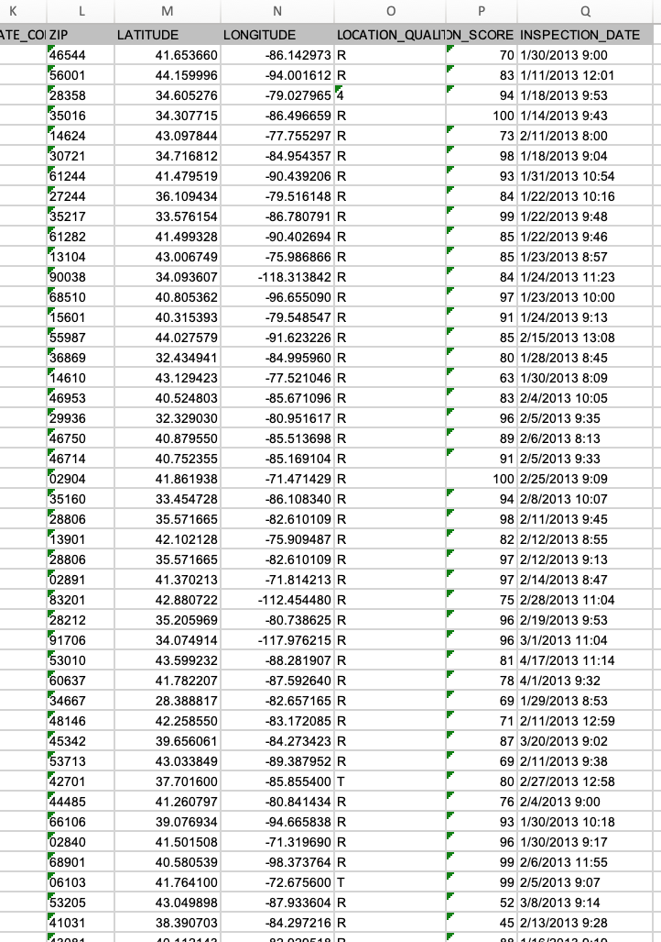
Housing Data from HUD.gov
Data set focuses on housing inspection scores for multifamily public housing units across the US on a scale from 0-100
19000+ Rows of data – 17 columns with 18171 rows non-missing data - Robust
Focused on Inspection Scores and supervised learning using linear model
Used Plotly library and linear model fit and experimented with clusters
z
Notes:
Audience e models policy makers could use to begin hypothesis testing for quality of homes and housing US multifamily public housing unit?
Can we ask better questions about public housing in US?
What are some questions we can draw from the data
Also experimented with clustering as an unsupervised technique
HUD's Real Estate Assessment Center conducts physical property inspections of properties that are owned, insured or subsidized by HUD, including public housing and multifamily assisted housing. About 20,000 such inspections are conducted each year to ensure that assisted families have housing that is decent, safe, sanitary and in good repair. This page provides a full historical view of the results of those inspections, providing point-in-time property scores. Results are available for download as a comma-delimited dataset. Separate datasets are available for public housing and for multifamily assisted properties. The results represent the inspections conducted from 2001 through January 2015. The dataset includes property identifiers and location information.

Slide 4
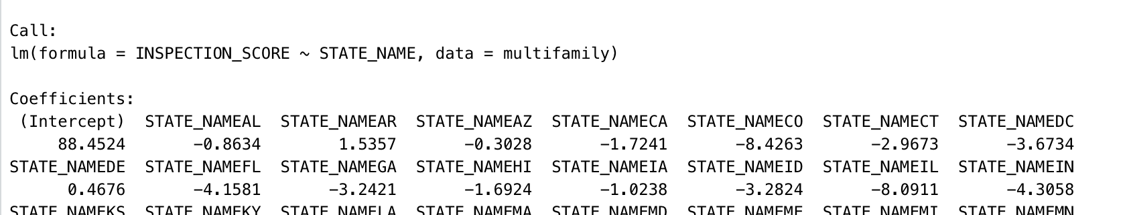
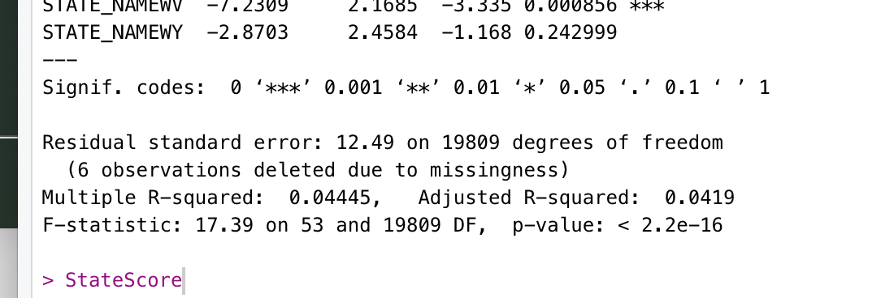
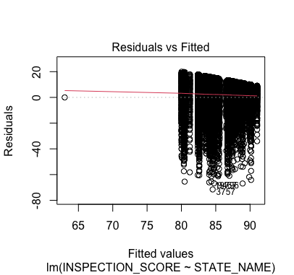
Summary Statistics
Supervised linear model produced mediocre results - STATE_NAME as a predictor of Inspection scores was highly significant with a low p-value and an R squared of only .04
Median was also very high (88 out of 100) and represented the intercept.
Revisit inspection scores through unsupervised clustering concepts
Notes:
Supervised learning (SL) is the machine learning task of learning a function that maps an input to an output based on example input-output pairs. It infers a function from labeled training data consisting of a set of training examples.
I decided to focus on the areas of the country with the most significant p-values and revisit inspection scores through unsupervised clustering methods. I decided to focus on the areas of the country with the most significant p-values and revisit inspection scores through unsupervised clustering methods.

Slide 5
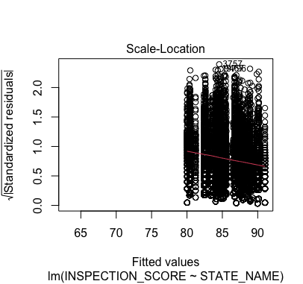
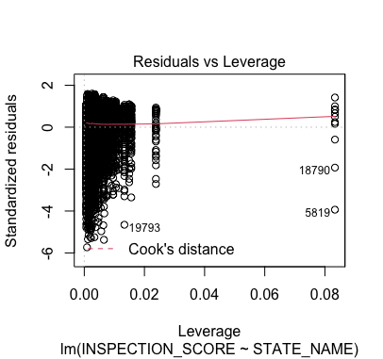
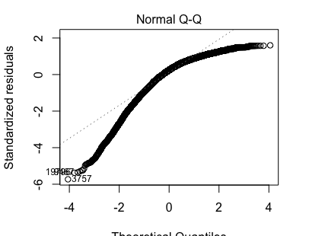
Summary Statistics Explanation
Scale- Location plot- the average magnitude of the standardized residuals changed after a score of 80 - indicating generally high scores
Residual vs leverage plot – indicated influential observations in a regression model which included significant outliers like – Group home in VA Beach and Auburn, NY Area
Q-Q plot- Some of the data is distributed in a normal format but there are outliers on the tails- such as in New Orleans, LA #3757
Notes:
STATE_NAMECO -8.4263 2.0303 -4.150 3.34e-05 ***
STATE_NAMEIL -8.0911 1.9716 -4.104 4.08e-05 ***
STATE_NAMELA -7.9828 2.0596 -3.876 0.000107 ***
West Virginia
The q-q plot is used to answer the following questions: Do two data sets come from populations with a common distribution?
Do two data sets have common location and scale?
Do two data sets have similar distributional shapes?
Do two data sets have similar tail behavior

Slide 6
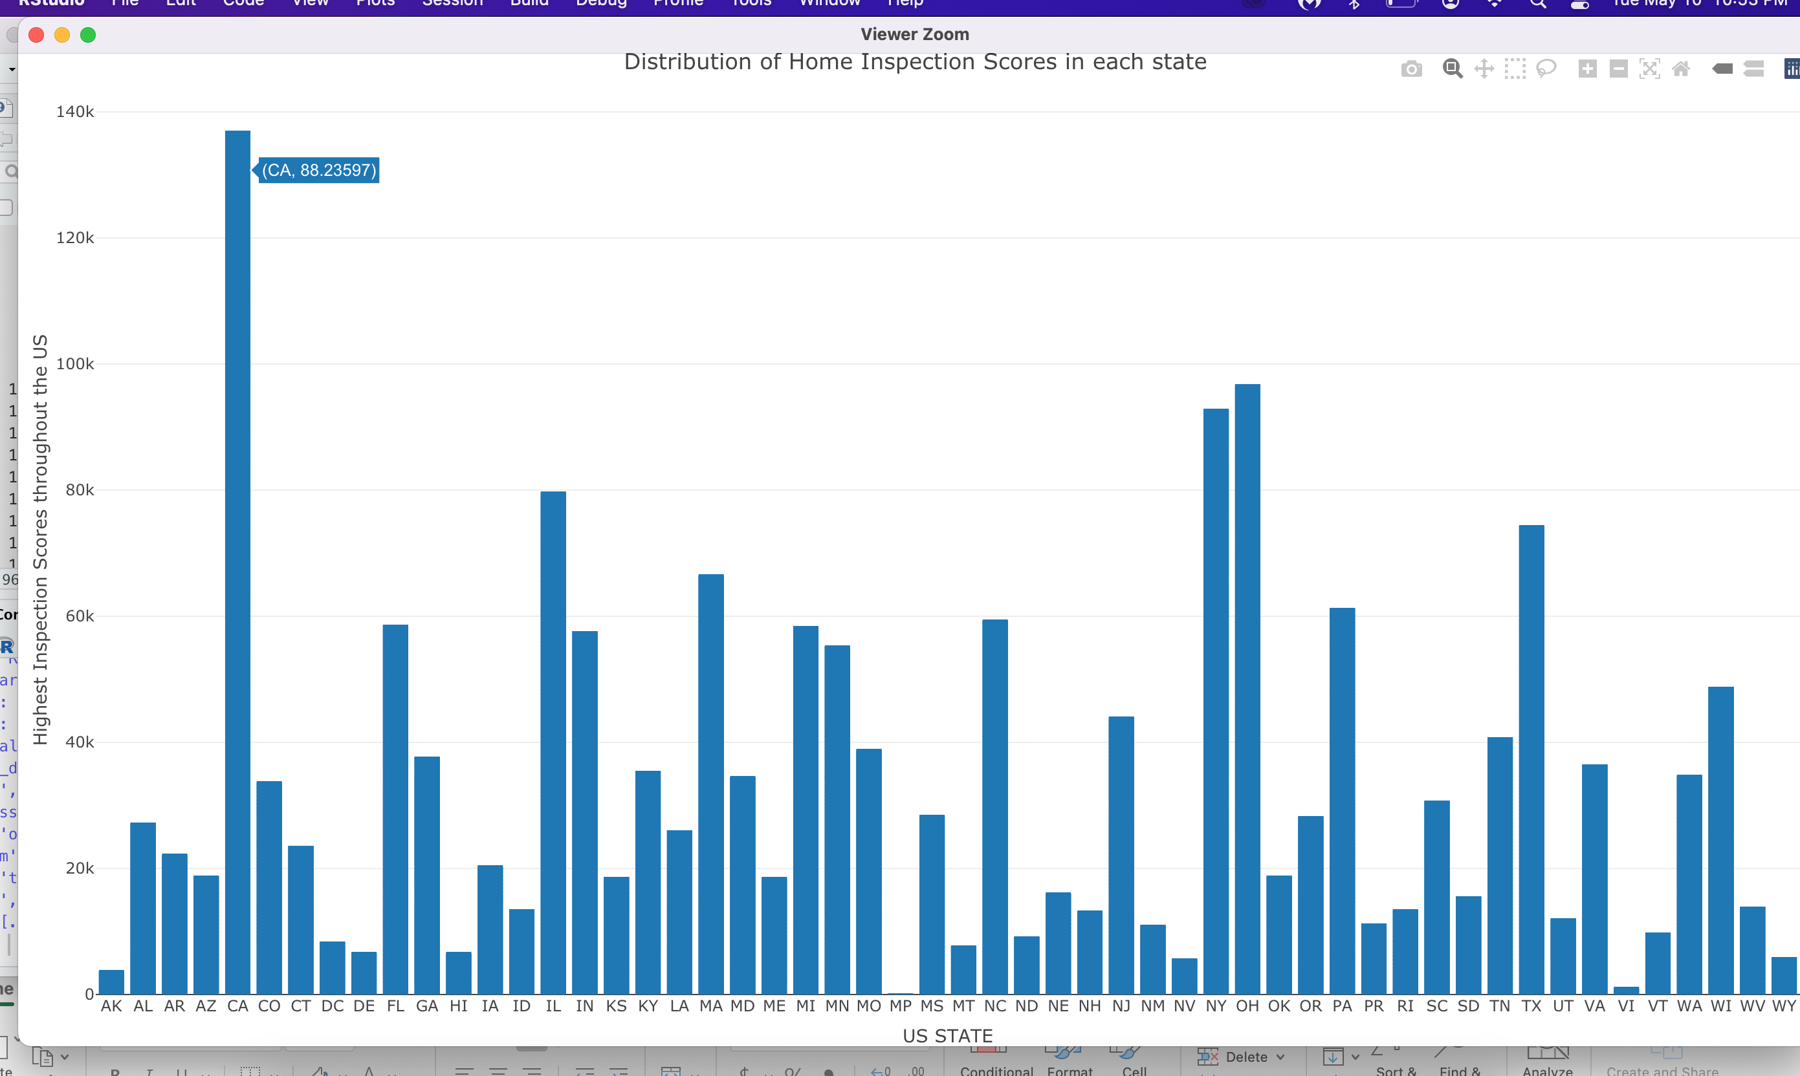
Plotly Bar chart for Cumulative Home Inspection Scores from 2001-2015
California, NY, Ohio, Texas and Illinois may be of interest – Scaled by their respective scores

Slide 7
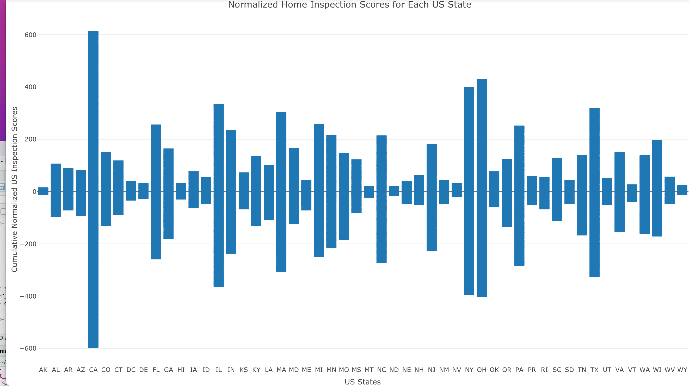
Standardized model for US State Inspection Scores from 2001-2015
Notes:
Used R- norm function to set mean equal to zero
More volatility in public housing in areas like CA, NY, OH, IL and Texas
Less volatility in AK, HI, MS, ND, NV, WY

Slide 8
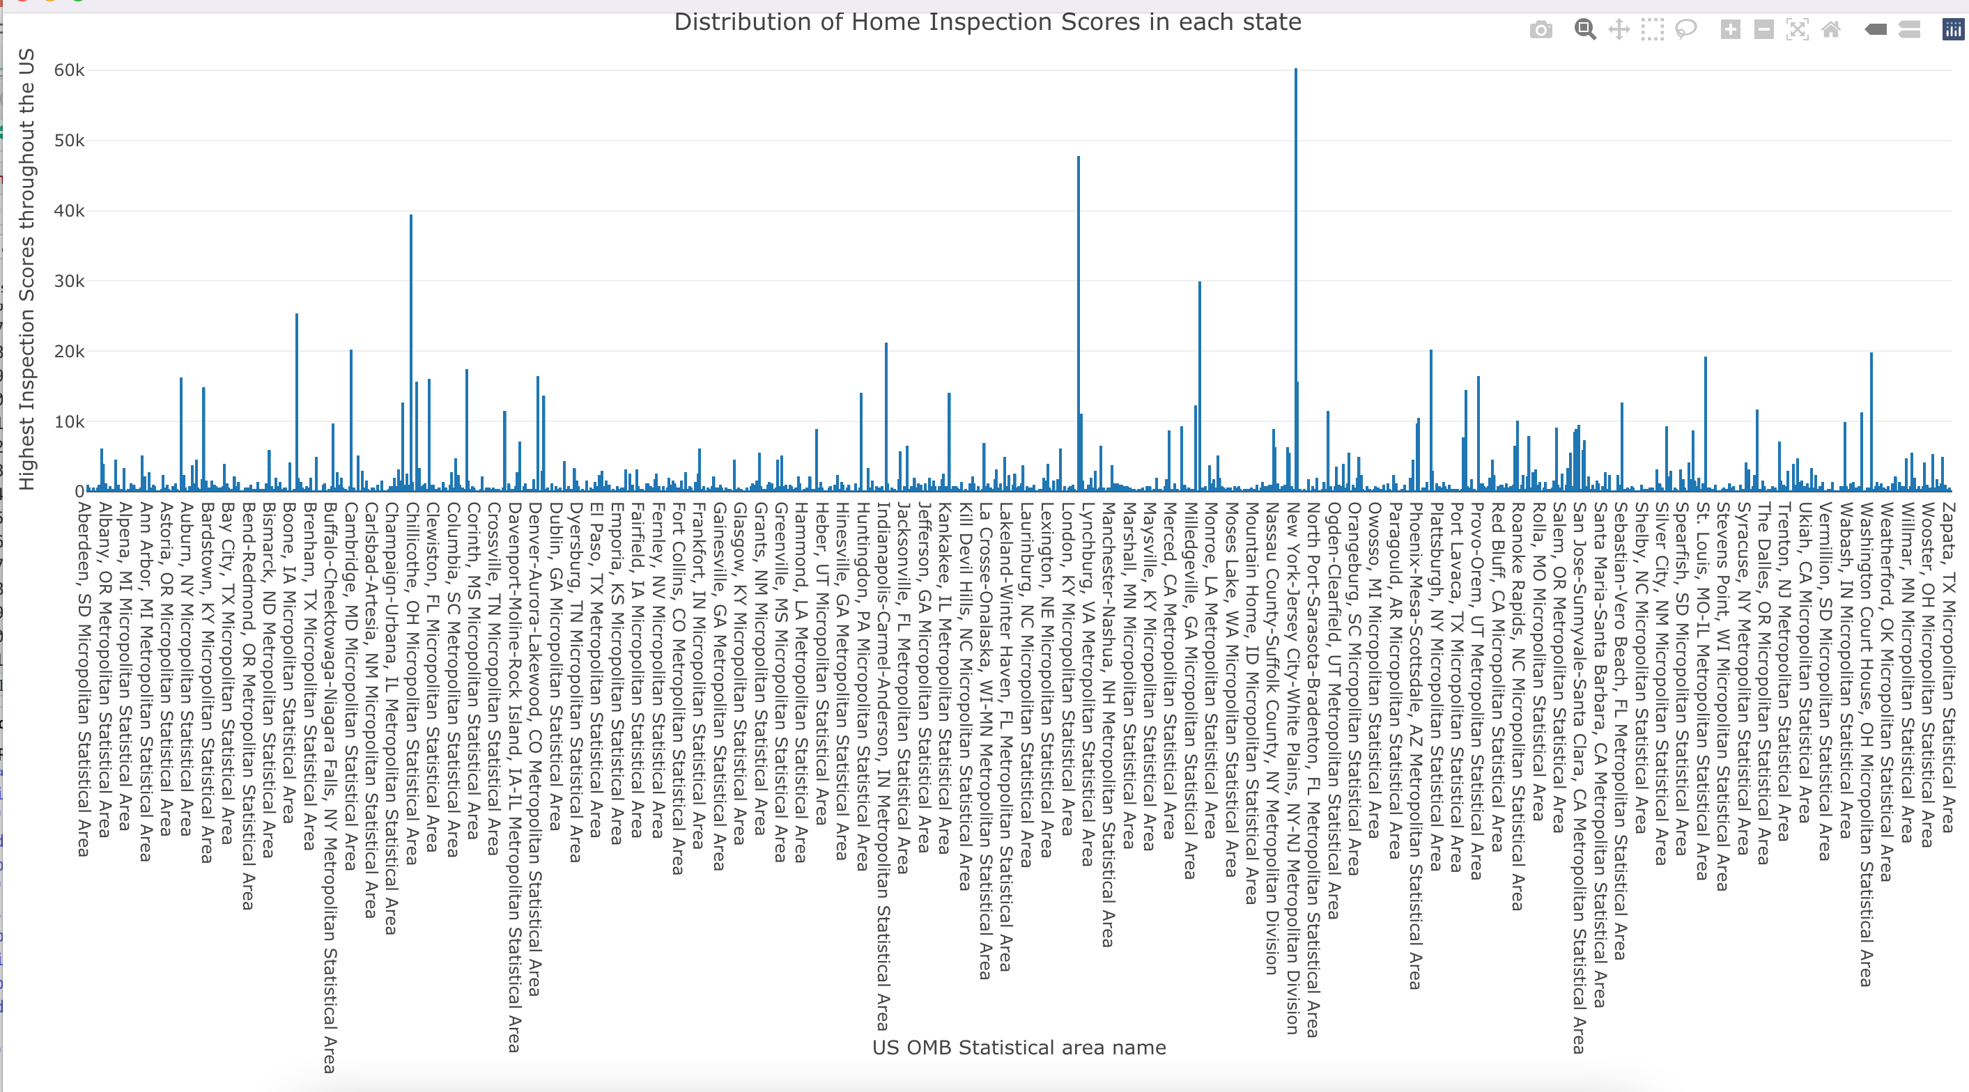
Federal Statistical Area Name and Home Scores
Areas of interest: Ohio, Lynchburg, VA, Milledgeville, GA, New York Jersey City Area
Notes:
Core-based statistical area name. The term "Core Based Statistical Area" (CBSA) is a collective term for both metropolitan and micropolitan statistical areas, which are geographic entities defined by the U.S. Office of Management and Budget (OMB) for use by Federal statistical agencies in collecting, tabulating, and publishing Federal statistics

Slide 9
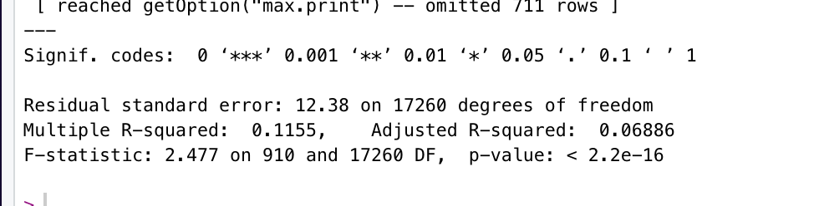
Conclusion
Core Based Statistical area name approximated inspection scores better than States, Longitudes or Latitudes – indicating more influence of OMB Statistical Analysis of areas with an intercept of ~89
Residuals were very high in model for State but p-values were also very low
Generated better questions by focusing on cross validation
  Utilize concepts of Hartigan rule and cross validation with Federal core-based statistical area name and States partitions
  Areas for further study: Control clusters principal component analysis for studies of housing
  Agglomerative clustering for variables and cases
Notes:
Residuals
angular distance north or south from the earth's equator measured through 90 degrees
This function produces two variants of the conditioning plots discussed in the reference below.
High inspection scores may indicate higher standard of living and these were higher in the Federal Statistic areas not the state areas

