Slide 1






Child Sex Abuse Awareness Program
Happy Child Society Partnership Brochure
Emi Akiode, Nonprofit Advocate and Executive, PMP
Nonprofit 501c3 EIN: 87-1695152
March 2024
www.pmp-101.com/newsletter Password: Funding22
Established since: July 2021

Slide 2
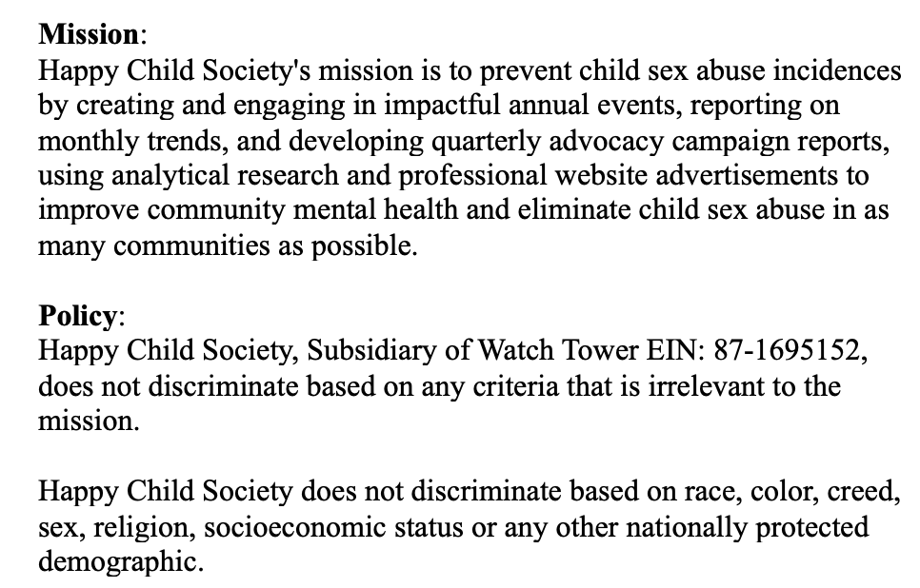
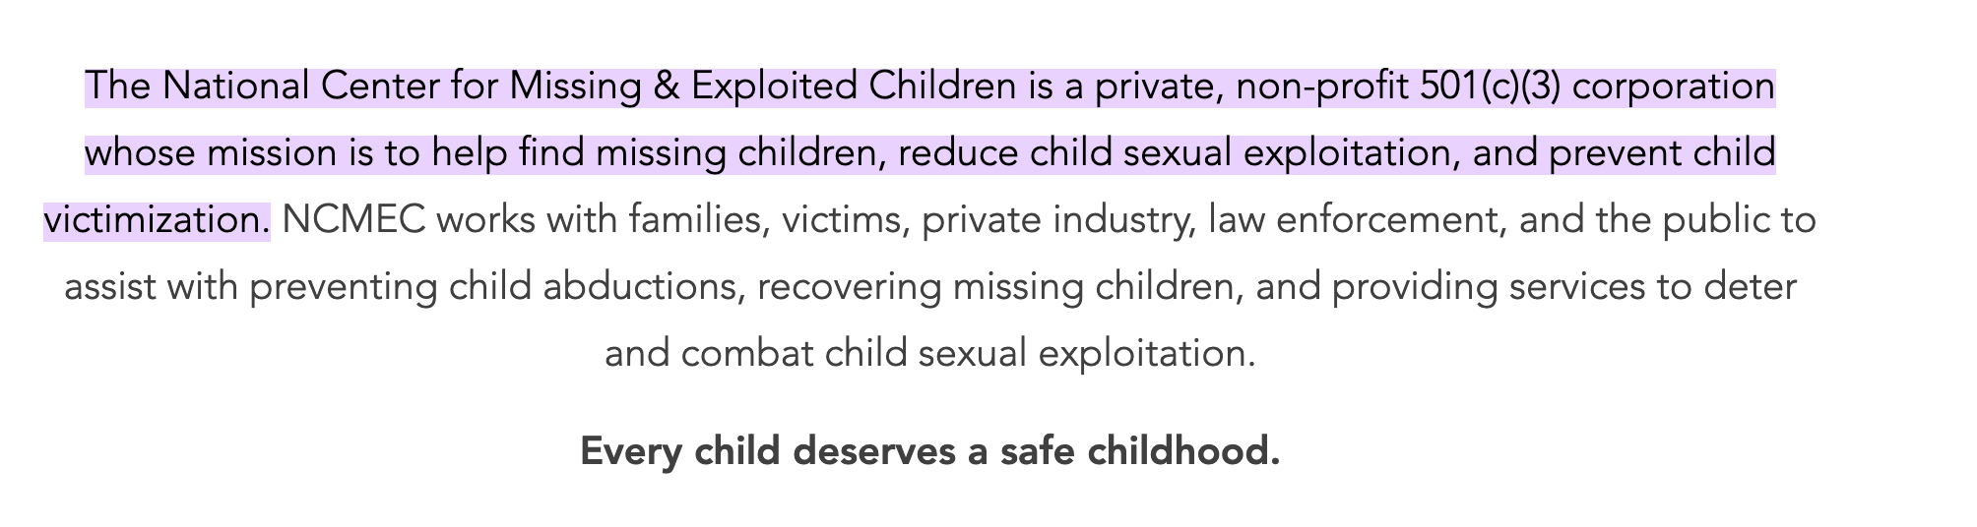
Presentation Purpose
To inform the National Center of Missing and Exploited Children (NCMEC), of the usefulness of using The Watchtower: Happy Child Society’s network, knowledge, and nonprofit enterprise environmental asset base to prevent child victimization.
Happy Child Society and the NCMEC share similar mission statements prevent child sexual exploitation and Happy Child Society has attained a significant level of success in a short time frame because of employing hybrid data analysis enterprise capabilities at a highly advanced level.
Our proprietary technology has caught the attention of quantum research centers at the Department of Homeland Security, and we are seeing early success at an astonishing rate despite limited budget in a highly constrained and regulated cyber environment.

Slide 3
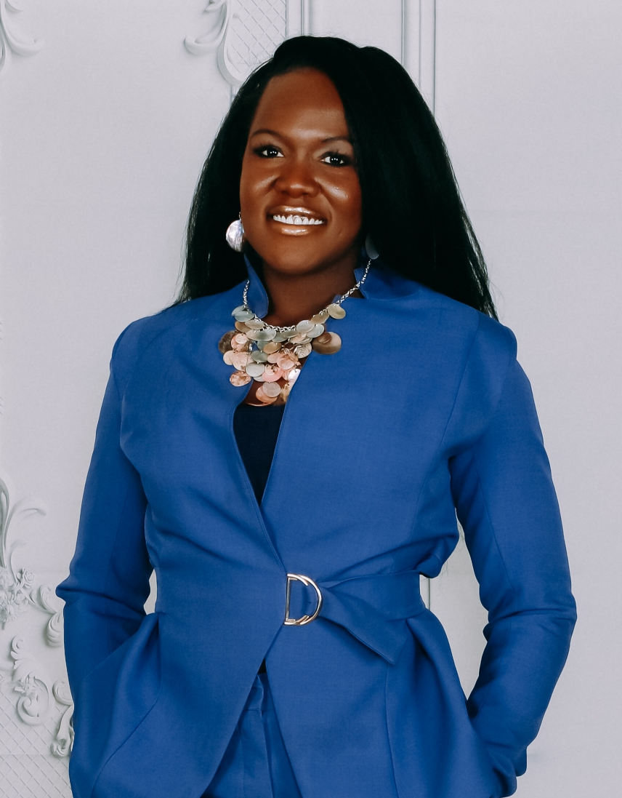
Leaders who have survived and overcome child abuse are the best to lead and uncover preventative solutions
Emi Akiode, PMP, BA in Public Policy and Economics and graduate certificate in data analytics, is the Happy Child Survivor executive and specializes in complex program community issues involving cancer fundraising and youth mentorship, whether in events, grassroots campaigns, social club memberships, or nonprofit/government inter-organization partnerships.
She has edited the program and project management standards for the American National Standards Institute and the International Organization for Standardization from the Project Management Institute (PMI) (2021 and 2023) and co-authored key risk and event management protocols for various federal departments.
Child abuse survivor with a proven track record of improving child abuse and mental health outcomes for mentees and clients due to leadership and demonstrated resilience during 8-month campaign schedule and limited budget. Demonstrated success in November 2024 as given in this PowerPoints' testimonials.
https://pmp-101.com/emi/ - Our strength lies is revealing missing values and hidden data or personas within teams and organizations and we have 15 years of experience of operating in this manner as of Jan 2025.
Notes:
*Emi is pictured here by Rose Knight Photography, Reston, VA, and looks younger than her years due to enthusiasm for fitness*
As a professional and executive for this campaign, I have received endorsements from the Department of Homeland Security, Noblis (a government contractor), Bill and Melinda Gates Foundation, Project Management Institute and the American Society of Quality, and Watchtower Nonprofit subsidiary (EIN: 87-1695152).

Slide 4
“I over-heard talking about a custody battle over the phone and didn’t want what happened to me to happen to them.”
Quote from 10-year-old girl on November 23, 2024, when speaking about adult indecent exposure in child protective service interview with Loudoun County, VA Family Services Specialist, Department of Family Services, Child Protective & Prevention Services
10-year-old had a role in preventing further child abuse, and I facilitated this meeting by gaining the trust of the mother and daughter
Roadblock: Loudoun County police required the accused abuser to admit the abuse that occurred 2 years ago. The police and pro-bono child lawyers are hesitant to pursue tracking warrant or eDiscovery methods (i.e. porn on accused phone or probable cause evidence)
Loudoun County Police Report Case number: SO240021060 *personal notes from child protective interview included below*
Notes:
Alice:
Friday night friends 2018-2019
Walked dog with Hailey
Richard was his caregiver
Liked to spend time with her saw Richard and Hailey’s kid
Social worker to Lena:
Brave for doing this - tell a safe adult you trust
Alice:
Hasn’t seen him in a couple of years
Richard is in early or mid 20’s- likes social worker’s long nails
Help fix things with her- father go to the job site with his father
Father contractor - took Hailey shopping
Lena:
One time - alone sitting watching him playing but Alice was in the bathroom
Alice:
Give baby a bath - Richard was getting paid
Back in touch - write you a letter before we found this -
Social worker:
contact within 48 hrs.
Social worker:
How is Lena?
Lena:
Ok
Social worker:
How is Lena feeling?
Lena:
Weird
Social worker to Lena:
“ Worried that you are Getting someone in trouble?”
Social worker:
Not always the easiest
Law enforcement is involved - reached out
Alice:
Two little ones - 5 year old - also has learning disability
2 years old
Reported it once
5 year old said: “Because dad touches me there”
No contact for years
Not helping out- once they were over his house and he got angry
Called the police - “he said, she said”
Richard Put hands on her?
Alice and Lena relocating to Michigan, Romulus
21st of Dec - Medical diagnosis
Engage in counseling
Who is a professional with school
Social Worker:
Insurance through Dad?
Alice
Yes, Blue Cross Blue Shield
Social Worker:
Her Address- lives in Ashburn with his mother
Grandma - Father - protective - Great uncle - 2 in Michigan cheaper there than in Loudoun
Alice Lived in Loudoun, born here in Loudoun County- moved to Georgia when 9 years old moved back to Loudoun at 9 years old?
Social Worker:
Called as a shocker - emotional
Tomorrow - assigned and picked up as child advocacy
Social Worker:
Counseling vs. forensic interview retraumatizes - tell story bring charges on him - if they feel they have enough
Alice:
Talking to Hailey - Hailey told mother - worried about criminal custody themselves- battle - trying to get - trying to do - seen in house
Last birthday came to see Alice’s Dad
Social Worker:
He had access to her? See safety plan print out
(Safety Plan- included recommendation to avoid contact with Richard Shaw, situation: because Exposed himself to a minor child)
Lena:
He was there and looking
Acts so nice around everyone
Saw him at the bus stop
Always standing there
Cell phone with daughter - sister here to make sure
Social Worker:
Coordinate with talk
Lena:
What if he will do if found out I told?
Alice and Social worker:
Find appeal - who is a detective
Alice is protected - Fresh start
Alice shared room with daughter Lena
Social Worker:
Hailey, Richard’s mate lives Sterling Green thorn Ave Sterling park Virginia
Now
Call 3pm tomorrow - orthodontist tomorrow
Alice:
She had seen him recently -
so he decide- Richard has access to 13 year old niece
Talking to dad- to all children
Lena:
Over heard talking about custody battle over the phone and didn’t want what happened to her to happen to them

Slide 5
November 2024 Loudoun County, VA Shocking Trauma Incident - Success Story
Who? – Single mother and her 10-year-old daughter in Sterling, Loudoun County, VA
What? – 10-year-old reported adult indecent exposure that occurred 2 years prior due to custody battle during mother’s phone conversation. This was a trigger as the girl overheard the custody conversation and she remembered that the man lingered around bus stop on occasion
When? – Met mother during community event on October 11, 2024, and she contacted me again regarding my non-profit child abuse prevention work on November 22, 2024.
Where? – Reported in Loudoun County: Sterling, VA 20165 child protective services interview held at Starbucks on November 24, 2024. Incident occurred in 2022 in Reserve at town center apartment complex on Reserve Falls Terrace, Sterling, VA, 20165
How? – Courageous girl who was brave enough to report a man who she remembered flashed her* two years ago and she had seen lingering near her bus stop on occasion
Why? – Shocking event that requires a thorough investigation and quick test of validity due to hear-say nature of the report
Warrant required at the federal level
Cousin showed up at the mother’s place of work in a threatening manner despite never having shown up there before
Police required admission of guilt with little recourse to protect women and children from obvious indicators (porn use, child indecent exposure on phone, and anonymous tips)
Despite this, our team gathered and conducted +33 interviews and phone calls to police, agencies, and local resources, on behalf of the mother, acting as a pro-bono child abuse lawyer for the case
Loudoun County, Virginia Police Report Case number: SO240021060
Notes:
*He said to her- I have a something to show you, look what the dog did to m. He then exposed his private parts to her and she claims he was aroused and, in a bed*

Slide 6
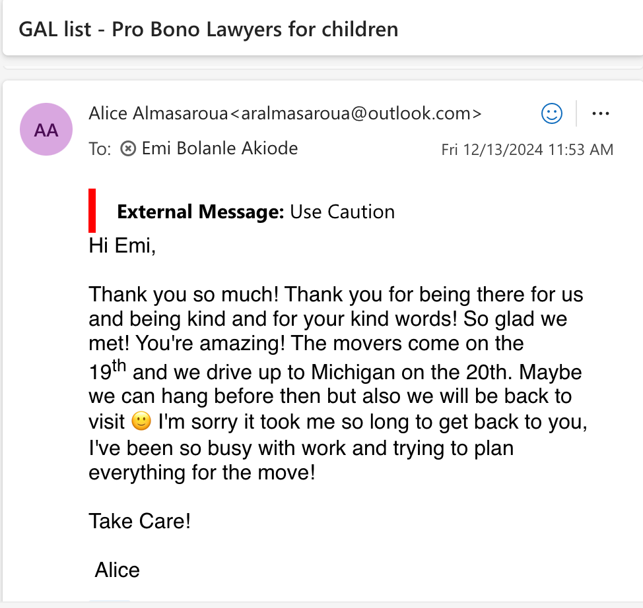
Continued: Loudoun County, VA Success Story
Improved mental health and support for this single mother and child using simple data analysis tools:
Decision flow chart, event-based software: Arena, Minitab, Branch and Bound methods, Simplex algorithm: Network models, Decision Trees
Happy Child Society, facilitated psychological safety in an optimally feasible and cost-effective manner, despite lack of adequate funds. We use child abuse survivor trauma-based perspectives unique to the complexity of the problem. Our team finds optimal solutions that satisfy the constraints of child abuse issues in a locally optimal manner that can translate to a global optimum (as evidenced in the email).
Long chain of events facilitated revelation of the ten-year old’s trauma that occurred 2 years ago. This incident will potentially help to prevent abuse for two other children (5-year-old and 2-year-old girl who are daughters of the accused)

Slide 7
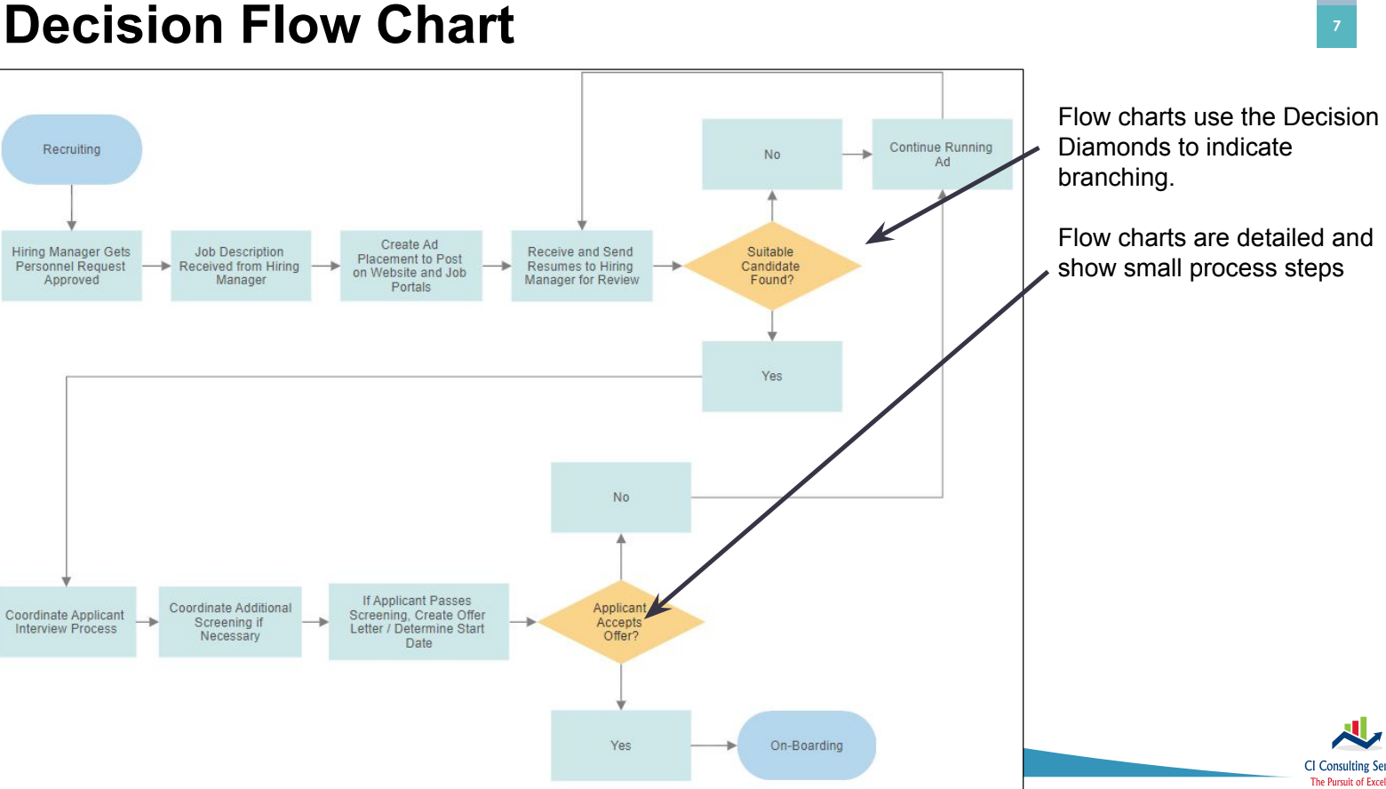
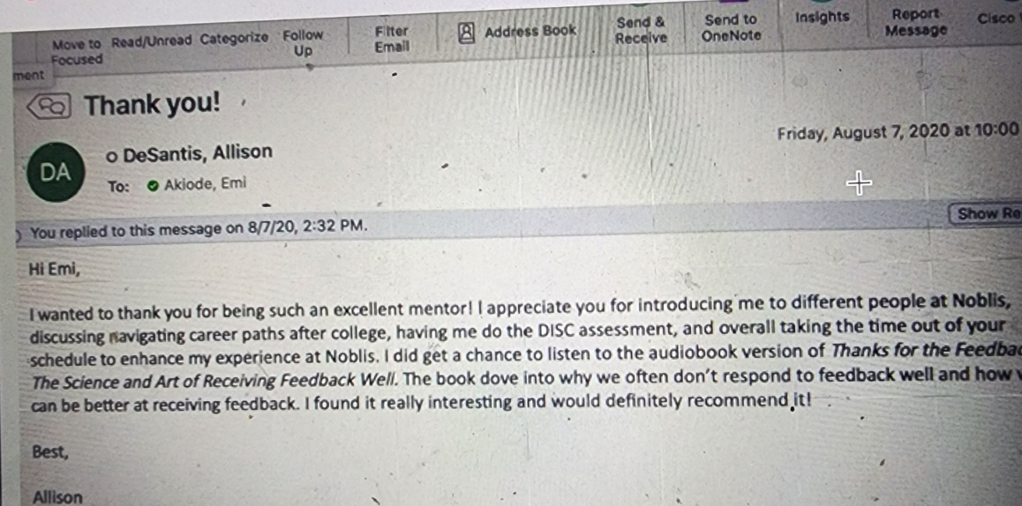
Mentor Successes
Conducted 3 young adult mentorships since 2020
Leader is a child abuse survivor and family supporter
Currently sponsored by 2 current member organizations at the Federal Level
Ms. Akiode experiences the joy of giving back as a community servant and leader
Notes:
As a professional and executive for this campaign, I have received endorsements from DHS, Bill and Melinda Gates Foundation, Project Management Institute and the American Society of Quality, and Watchtower Nonprofit subsidiary (EIN: 87-1695152).

Slide 8

Child Sex Abuse is a Widespread Problem and Prevention is the arguably the best cure
1 : 9
One in 9 girls
1 : 20
1 in 20 boys
82% of all victims under 18 are female*
Females ages 16-19 are 4 times more likely than the general population to be victims of rape, attempted rape, or sexual assault.
Notes:
*Understanding RAINN’s statistics
Sexual violence is notoriously difficult to measure, and there is no single source of data that provides a complete picture of the crime. On RAINN’s website, we have tried to select the most reliable source of statistics for each topic. The primary data source we use is the National Crime Victimization Survey (NCVS), which is an annual study conducted by the Justice Department. To conduct NCVS, researchers interview tens of thousands of Americans each year to learn about crimes that they’ve experienced. Based on those interviews, the study provides estimates of the total number of crimes, including those that were not reported to police. While NCVS has a number of limitations (most importantly, children under age 12 are not included), overall, it is the most reliable source of crime statistics in the U.S.
We have also relied on other Justice Department studies, as well as data from the Department of Health and Human Services and other government and academic sources. When assembling these statistics, we have generally retained the wording used by the authors. Statistics are presented for educational purposes only. Each statistic includes a footnote citation for the original source, where you can find information about the methodology and a definition of terms.
Learn more about RAINN's statistics.
Sources:​
United States Department of Health and Human Services, Administration for Children and Families, Administration on Children, Youth and Families, Children’s Bureau. Child Maltreatment Survey, 2016 (2018).
Department of Justice, Office of Justice Programs, Bureau of Justice Statistics, Sex Offenses and Offenders (1997).
David Finkelhor, Anne Shattuck, Heather A. Turner, & Sherry L. Hamby, The Lifetime Prevalence of Child Sexual Abuse and Sexual Assault Assessed in Late Adolescence, 55 Journal of Adolescent Health 329, 329-333 (2014)
Department of Justice, Office of Justice Programs, Bureau of Justice Statistics, Sexual Assault of Young Children as Reported to Law Enforcement (2000).
H.M Zinzow, H.S. Resnick, J.L. McCauley, A.B. Amstadter, K.J. Ruggiero, & D.G. Kilpatrick, Prevalence and risk of psychiatric disorders as a function of variant rape histories: results from a national survey of women. Social psychiatry and psychiatric epidemiology, 47(6), 893-902 (2012).
United States Department of Health and Human Services, Administration for Children and Families, Administration on Children, Youth and Families, Children’s Bureau. Child Maltreatment Survey. Exhibit 5-2 Selected Maltreatment Types by Perpetrator’s Sex. Page 65. (2013).

Slide 9

Societal Consequences of Child Sex Abuse
Long-lasting effects on the victim's mental health
  About 4 times more likely to develop symptoms of drug abuse
  About 4 times more likely to experience PTSD as adults
  About 3 times more likely to experience a major depressive episode as adults
Prevention is crucial because ad-hoc approaches may fail to improve mental health issues

Slide 10
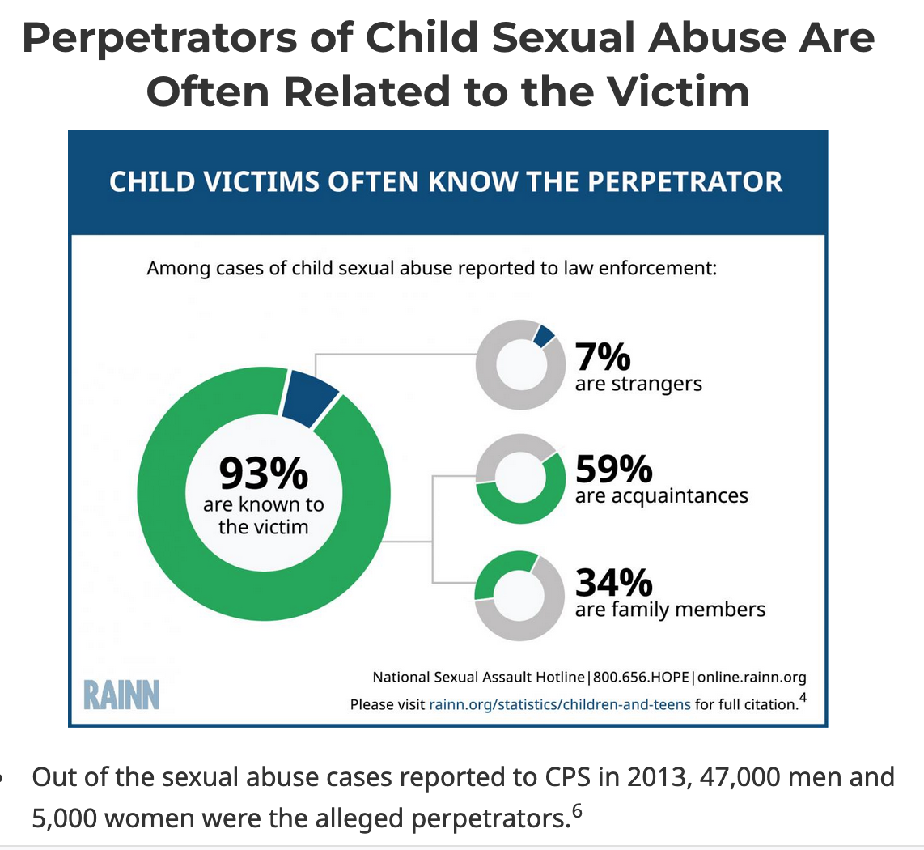
Systemic issue that is reported on every 9 minutes
Issues often remain unaddressed, and facts may be hidden in community and family groups for years!
z

Slide 11
How Happy Child Society Helps Business
Create awareness and fund research that support safe havens
We engage and send beneficiaries and sponsors quarterly newsletters, journals, and emails that contribute to business content, which can be hung in store or on bulletin boards to improve community activism! In 2023-2024, we have already received $9000+ in donations!
Prevent child sexual abuse misconceptions by attending events that promote family unity and healthy community relationships
Each membership offers sponsors the choice to collaborate on 2-10 pre-existing or new events, with professional spokespersons and representatives in attendance!
Monthly online advocacy to improve local community and business
Each membership tier offers sponsors professional website advertisement and citations, blog access, event photography rights, and expert commentary on specified websites!
Encouragement, mailings and gifts
Quarterly gifts boxes may include gift cards, chocolate, pizza, and fitness gift cards for families to the addresses on file!

Slide 12

Why Join This Advocacy Campaign?
Promote community awareness and support an unresolved and largely hidden widespread issue
Improve company and business reputation and increase collaborative profit margin through partnerships
Unique International Membership – United States Nationwide Designation
10 in-person event engagements (pre-existing events) and 2-10 virtual/hybrid event engagements (customized or new events)
12 monthly email newsletters on progress to improve community awareness and preventative measures
Attendance by spokesperson and advocate at 1-2 international events at the corporation’s discretion
Access to unlimited commentary and input in your business blogs, newsletters, surveys, networking invitations to the Project Management Institute and the American Cancer Society
2 Mailings per year- (magazines, gift boxes, snacks, gift cards, and nonprofit logo merchandise)

Slide 13

Benefits of Joining Advocacy Efforts
Member Category and Unique Initiation Benefits
  Full United States Membership – National Annual Designation
    10 in-person event engagements and 4 virtual event engagements annually
    12 monthly email newsletters on progress to improve community awareness and preventative measures
    Attendance by spokesperson and advocate at 1-2 international events at the corporation’s discretion

Slide 14

Benefits for Joining Advocacy Efforts
Member Category and Unique Initiation Benefits
  State Membership – National Annual Designation
    2 in person event engagements and 1 virtual event engagement annually
    4 quarterly email newsletters on progress to improve community awareness and preventative measures
    Attendance by spokesperson and advocate at 1 international event at the corporation’s discretion

Slide 15

Benefits for Joining Advocacy Efforts
Member Category and Unique Initiation Benefits
  Event Membership – Introductory Honorary Designation
    1 in person event engagement and 1 virtual event engagement
    1 month of emailed newsletters on progress to improve community awareness and preventative measures

Slide 16
Join now and our community will thank you!
Member Category | Honorary Benefits | Event Promotion | Communication | Event Management | Online Engagement Extension | Mailings | Annual Cost-Spring 2024
International Membership | Nationwide Designation Package | 10 in-person event engagements (pre-existing events) and 2-10 virtual/hybrid event engagements (customized or new events) | 12 monthly email newsletters on progress to improve community awareness and preventative measures | Attendance by spokesperson and advocate at 1-2 international events at the corporation’s discretion | Access to unlimited commentary and input in your business blogs, newsletters, surveys, networking invitations to quarterly events with the Project Management Institute DC Chapter and the American Society of Quality | 4 Mailings per year to 2 addresses (magazines, gift boxes, snacks, gift cards, and nonprofit logo merchandise) | $9,000-$35,000+
Full United States | Corporate Designation | 10 in-person event engagements (pre-existing events) and 2-10 virtual/hybrid event engagements (customized or new events) | 12 monthly email newsletters on progress to improve community awareness and preventative measures | Attendance by spokesperson and advocate at 1-2 international events at the corporation’s discretion | Access to unlimited commentary and input in your business blogs, newsletters, surveys, networking invitations to quarterly events with the Project Management Institute DC Chapter and the American Society of Quality | 2 Mailings per year to 1 address (magazines, gift boxes, snacks, gift cards, and nonprofit logo merchandise) | $5,000-$8,999
State Membership | Local Business Designation | 2 in-person event engagements (pre-existing events) and 1 virtual/hybrid event engagements (customized or new events) | 4 quarterly email newsletters on progress to improve community awareness and preventative measures | Annual email newsletter about spokesperson and advocate at 1 international event at the corporation’s discretion | Access to unlimited commentary and input in your business blogs, newsletters, surveys, networking invitations to quarterly events with the Project Management Institute DC Chapter and the American Society of Quality | 1 mailing per year- (magazines, gift boxes, snacks, gift cards, and nonprofit logo merchandise) | $1000-$4999
Event Membership | Event Designation | 1 in-person event engagement (pre-existing event) and 1 virtual/hybrid event engagements (customized or new event) | 1 newsletter on progress to improve community awareness and preventative measures after event and event impact assessment | Email awareness of spokesperson and advocacy in international events at the corporation’s discretion | Access to unlimited commentary and input in your business blogs, newsletters, and surveys | Magazines, gift boxes, snacks, gift cards, and nonprofit logo merchandise for guests at events | $750-$999

Slide 17
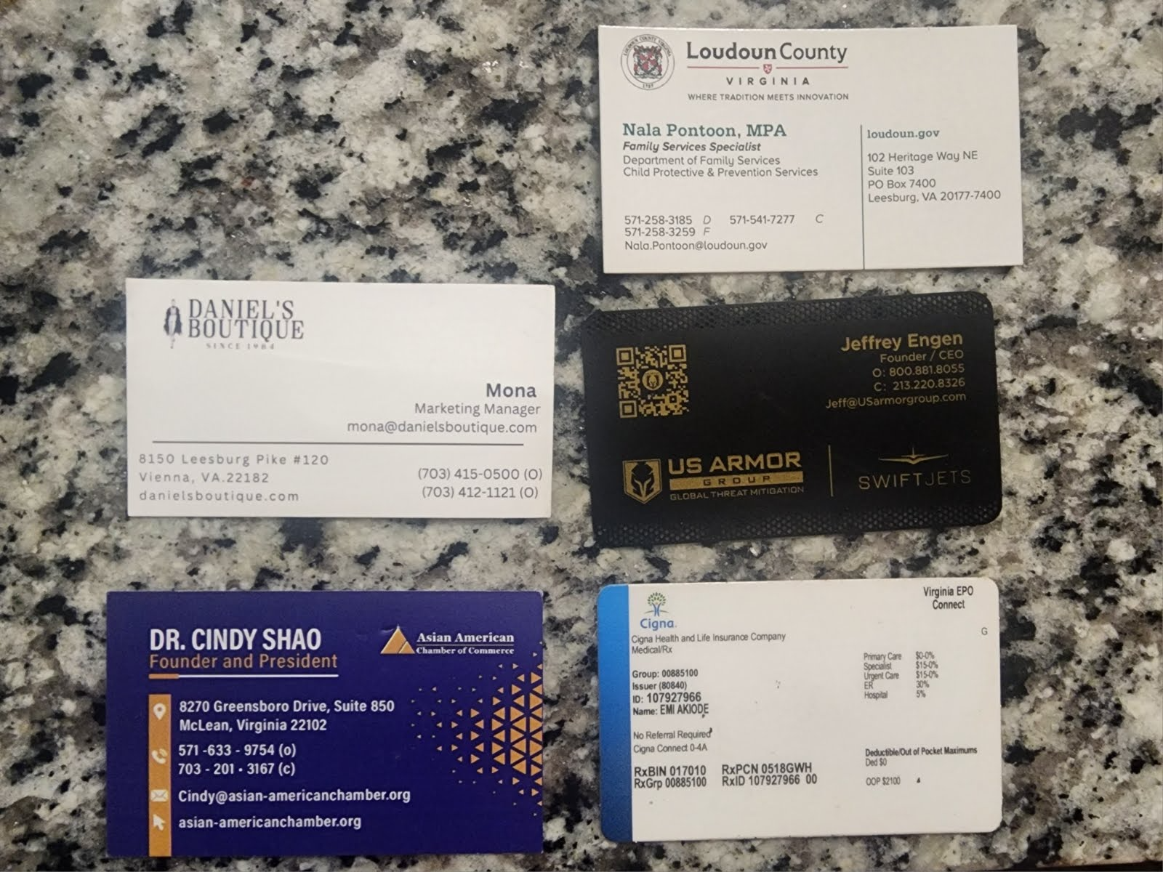

Program Affiliates
Happy Child Society’s expertise is revealing hidden or missing values that interfere with cybersecurity mission readiness and mission success, especially during events and affiliate programs
The executive leader, Emi Akiode, PMP, is world renowned for improving projects in any phases of service delivery, through adaptive lean, six sigma, and high safety and group intelligence approaches.
She is the recipient of 6 awards for government and philanthropic causes and currently operates as an executive and grant-maker on the board of a 501 3(c) nonprofit for abuse survivors, Happy Child Society, EIN: 87-1695152: Link
Other affiliates: ISO, ANSI, NIST, NSF, AFRL, HHS
Project Management Institute
George Mason University
American Society of Quality
Notes:
https://pmp-101.com/track-record/

Slide 18
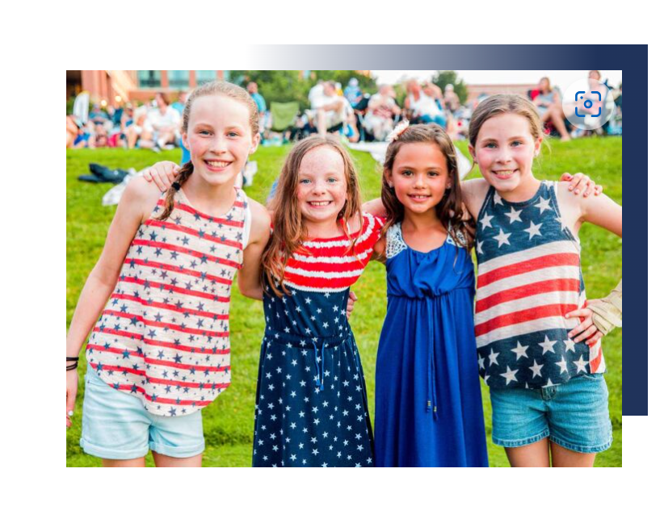
August 31st, 2024, Labor Day Event
Happy Child Society received $600 in donations from The Department of Veteran’s Affairs, The United States Secret Service, and Loudoun County Police, during a Labor day event which featured giveaways, professors, speakers, ambassadors, and research presentations on August 31!
Office Location: 20509 Reserve Falls Terr, Suite 304, Sterling, VA, 20165

